Slide 1

Hacksmash
The art of the Hackathon

Slide 2
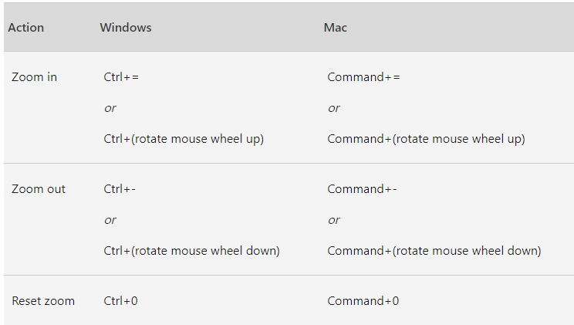
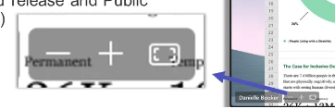
Zoom in and out in Microsoft Teams

Slide 3
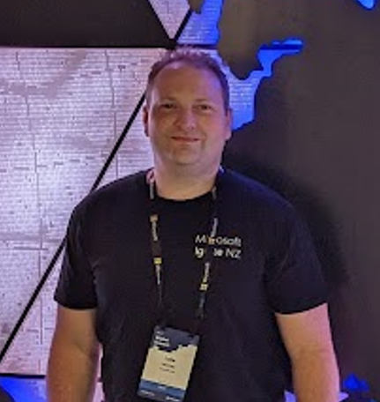

Hello!
Thank you for joining us today
Speaker: Luke Murray
Microsoft Learn Expert and Microsoft Azure MVP, and Senior Consultant from Hamilton, New Zealand.
https://x.com/lukemurraynz
https://www.linkedin.com/in/ljmurray/
https://luke.geek.nz/
https://www.youtube.com/@lukemurraynz

Slide 4
Q. Have you participated in a Hackathon before?
If so, what was your experience? What did you like or dislike?

Slide 5
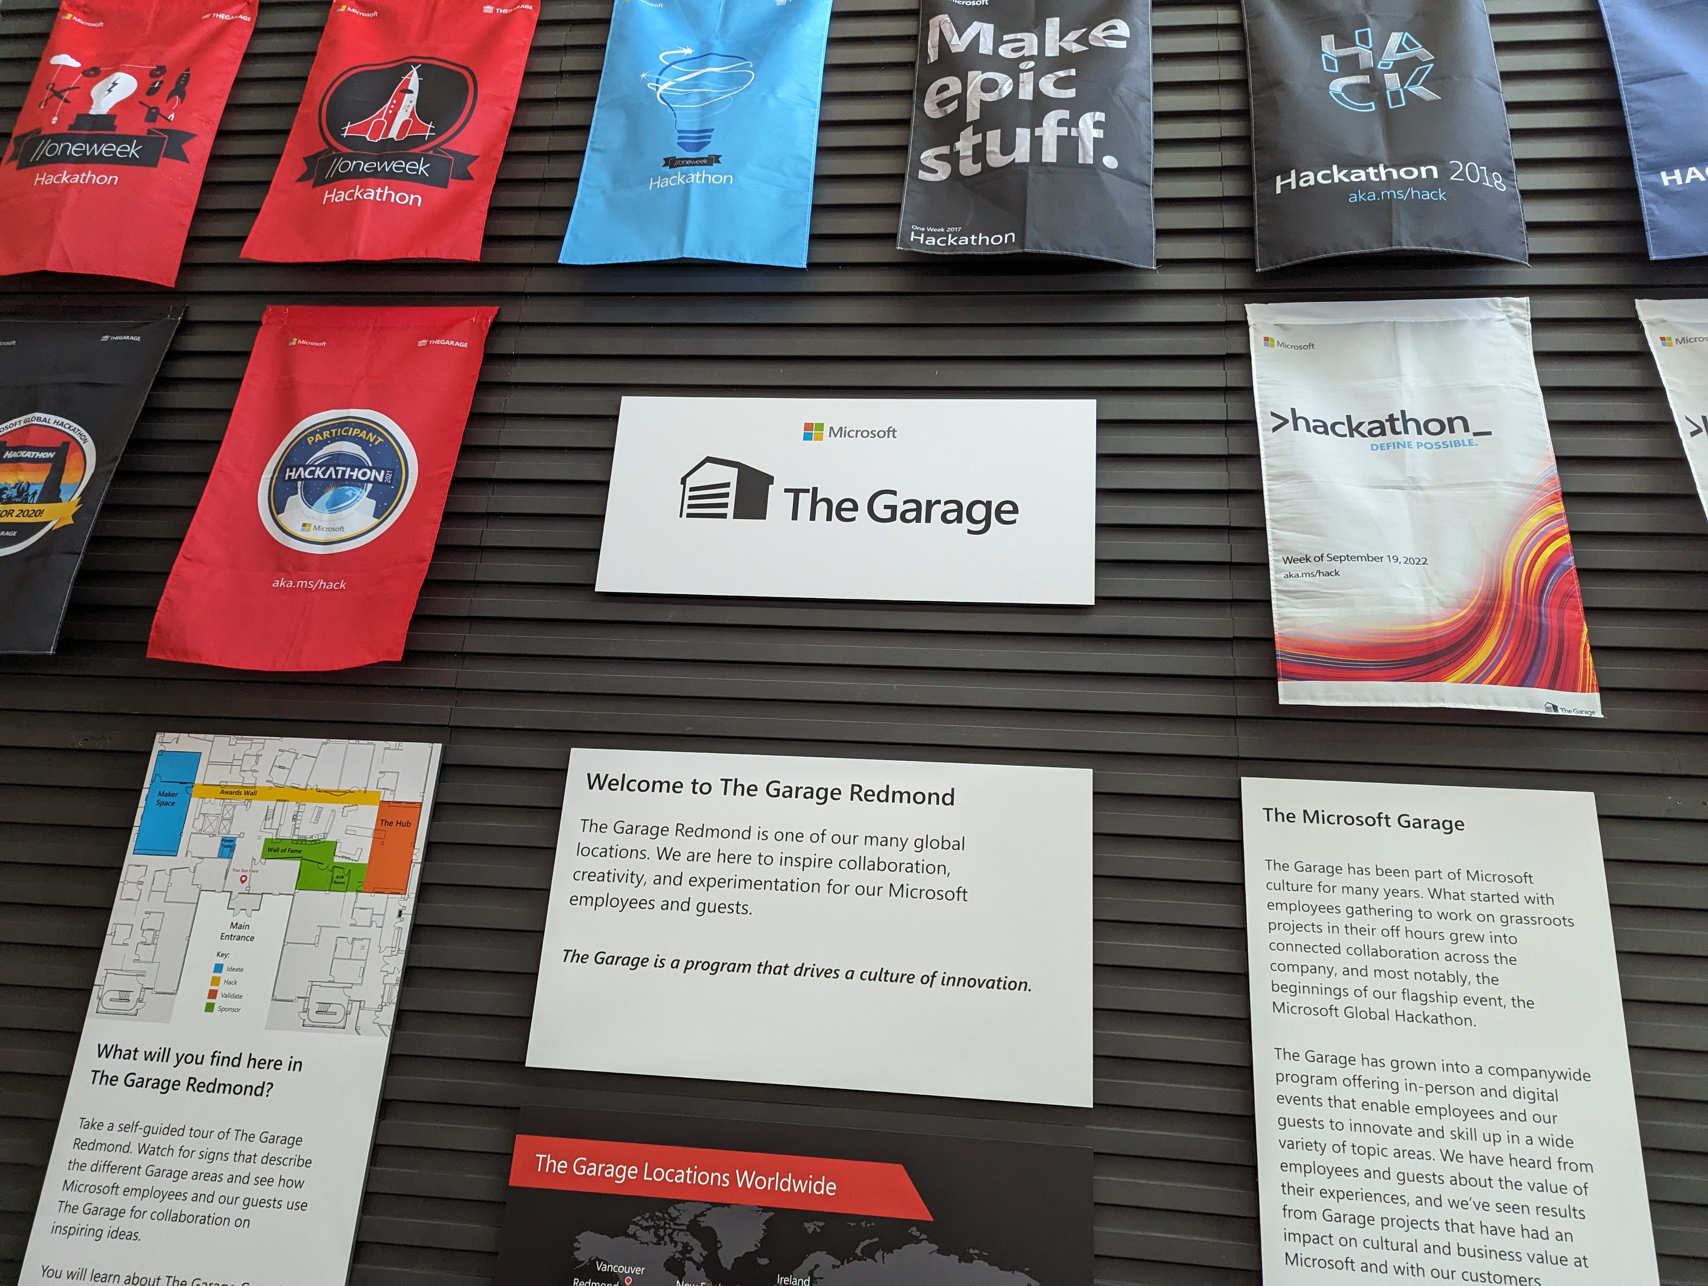
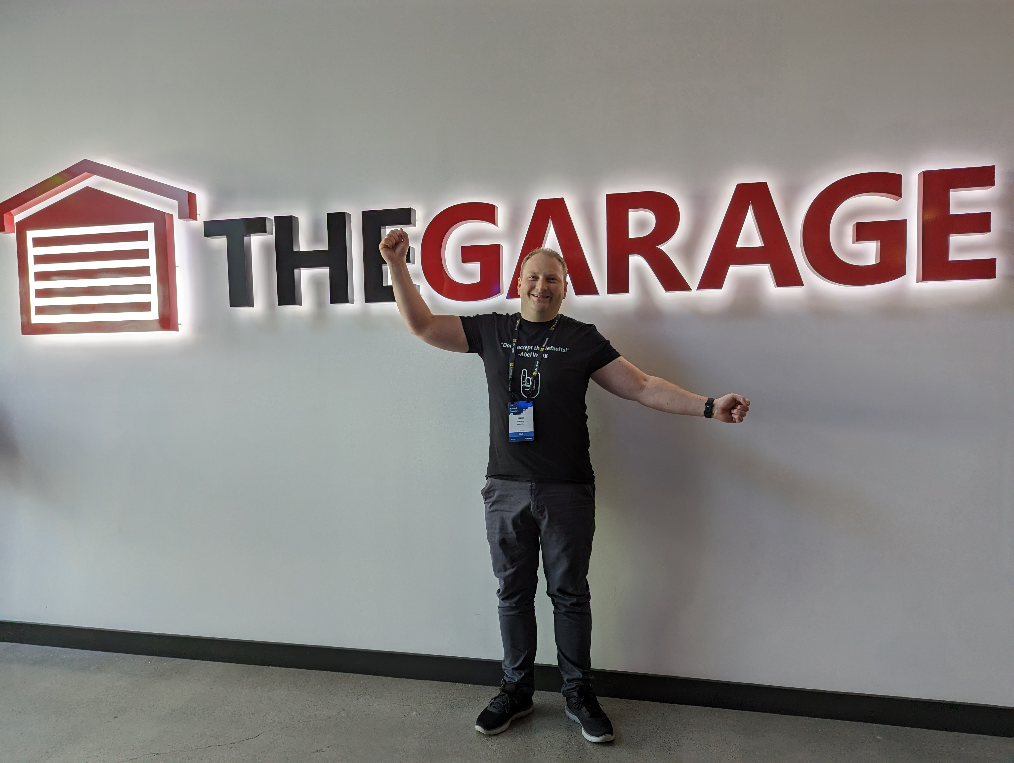
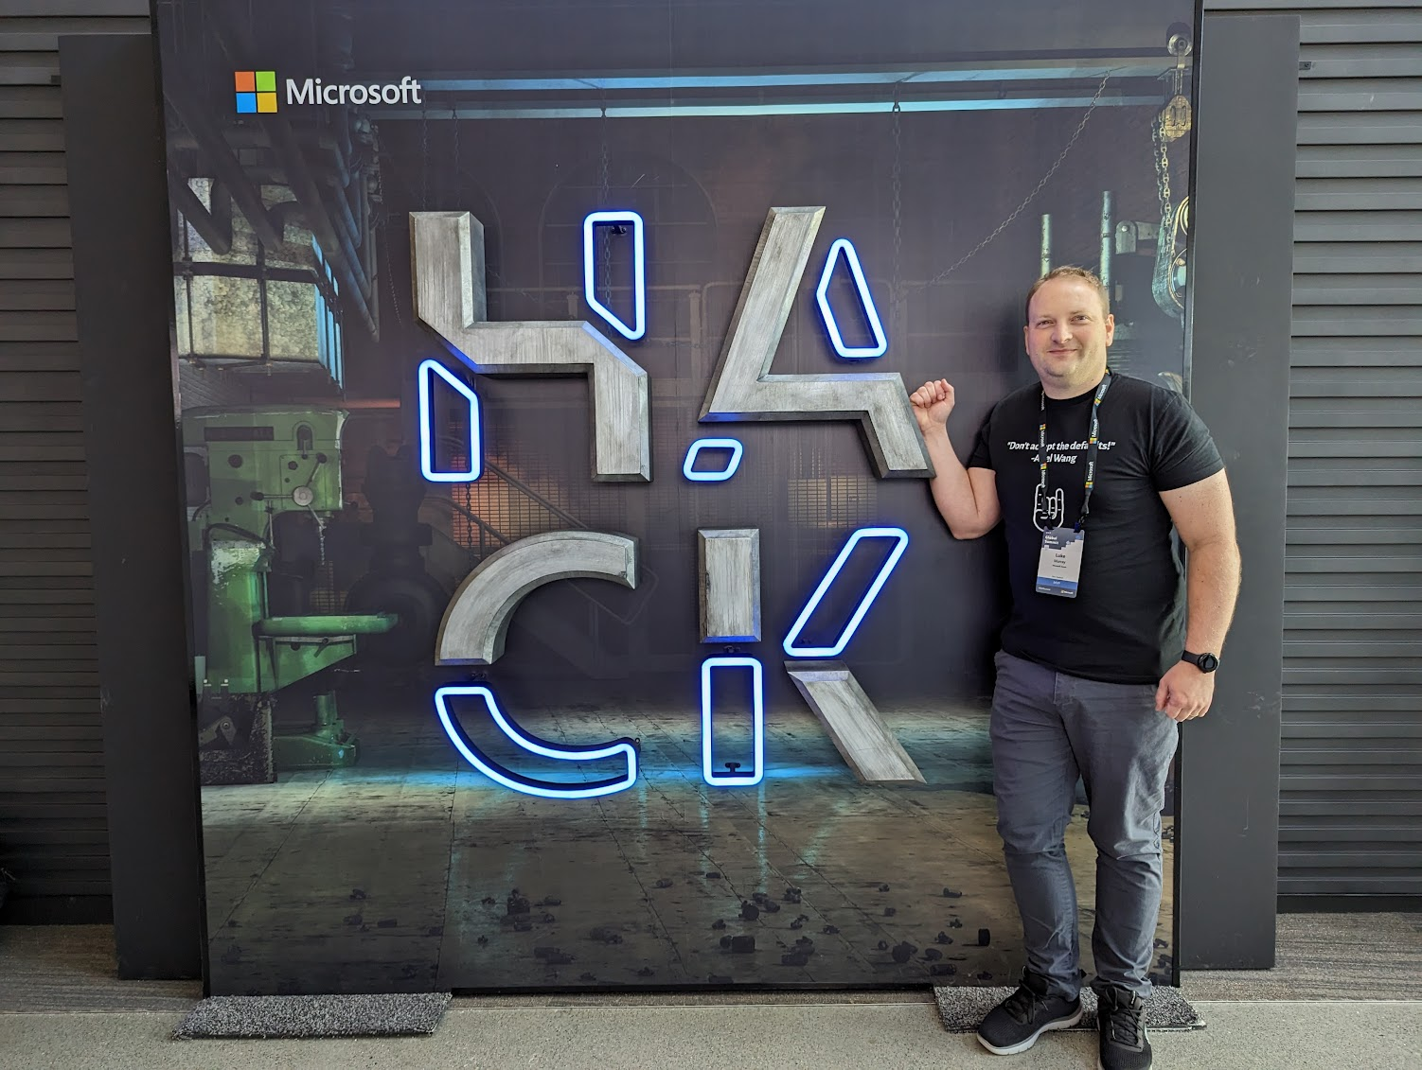

Slide 6
Definition of a Hackathon
“A hackathon (also known as a hack day, hackfest, datathon or codefest; a portmanteau of hacking and marathon) is an event where people engage in rapid and collaborative engineering over a relatively short period of time such as 24 or 48 hours. They are often run using agile software development practices, such as sprint-like design wherein computer programmers and others involved in software development, including graphic designers, interface designers, product managers, project managers, domain experts, and others collaborate intensively on engineering projects, such as software engineering.”
~ Wikipedia

Slide 7


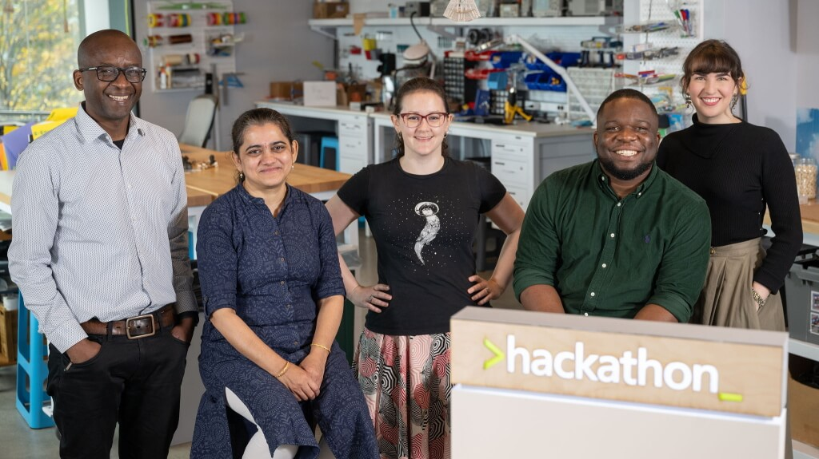
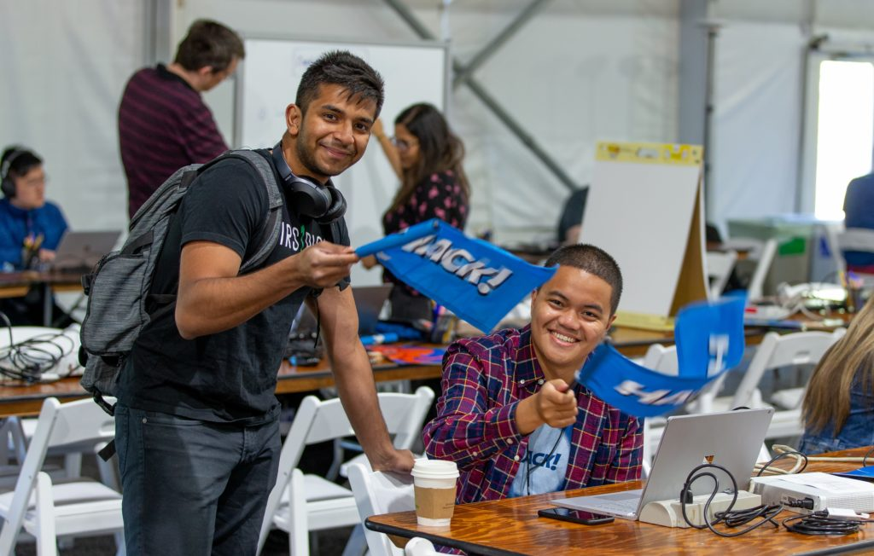
Microsoft Global Hackathon

Slide 8
Types of Hackathons
Type | Challenges | Benefits | Example
In-person | Higher costs (venue, catering, etc.) Limited to local participants Potential scheduling conflicts Requires physical space and resources Health and safety concerns (e.g., during pandemics) | Deeper networking opportunities Stronger team building Better for hands-on collaboration Easier to create excitement and energy Immediate face-to-face problem-solving Easier to manage team dynamics | Hackathon.com organized a 48-hour innovation challenge in San Francisco with developers, designers, marketers and innovators who gathered to create innovative solutions around educating patients and parents on vaccination in general, on the overall benefits and risks before seeing a healthcare professional.
Online-only | Potential for technical issues Harder to build team rapport Difficulty in maintaining engagement Time zone challenges for global events Less spontaneous interactions Harder to manage team dynamics remotely | Global reach and participation Cost-effective Flexibility in scheduling Easier to record and document Accessible to more participants Environmentally friendly (reduced travel) | Hackathon.com organized a 2-day online team building Hackathon where Walmart employees formed teams and submitted innovative projects to boost Walmart's sustainability. Throughout the hackathon, Hackathon.com staff followed-up individually with Walmart teams to monitor progress and animate several team building activities.
Hybrid | Complex to organize and manage Ensuring equal experience for online and in-person participants Higher technical requirements Potential for disconnection between online and in-person teams Balancing activities for both formats More challenging to create a unified event experience | Combines benefits of both in-person and online Increased flexibility for participants Wider reach while maintaining some in-person elements Can accommodate different preferences Potential for more diverse teams | Microsoft Global Hackathon, covering Microsoft FTE (Full Time Employee) staff from Redmond, and global divisions such as APAC, UK, strategic Microsoft Partners and Microsoft MVPs.

Slide 9

Define Purpose and Goals of your Hackathon
Next cutting-edge feature or product
Solving particular problems
Culture initiatives
Out-of-the-box

Slide 10
Define Purpose and Goals of your Hackathon
“Innovation generally comes from the edges of your organisation or ecosystem.”
Next cutting-edge feature or product
Solving particular problems
Culture initiatives
Out-of-the-box

Slide 11
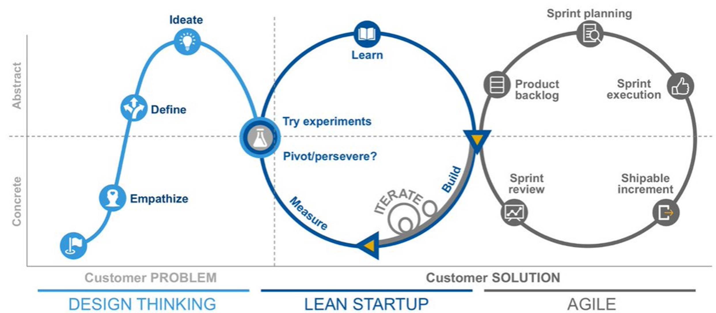
Planning for Hackathon

Slide 12
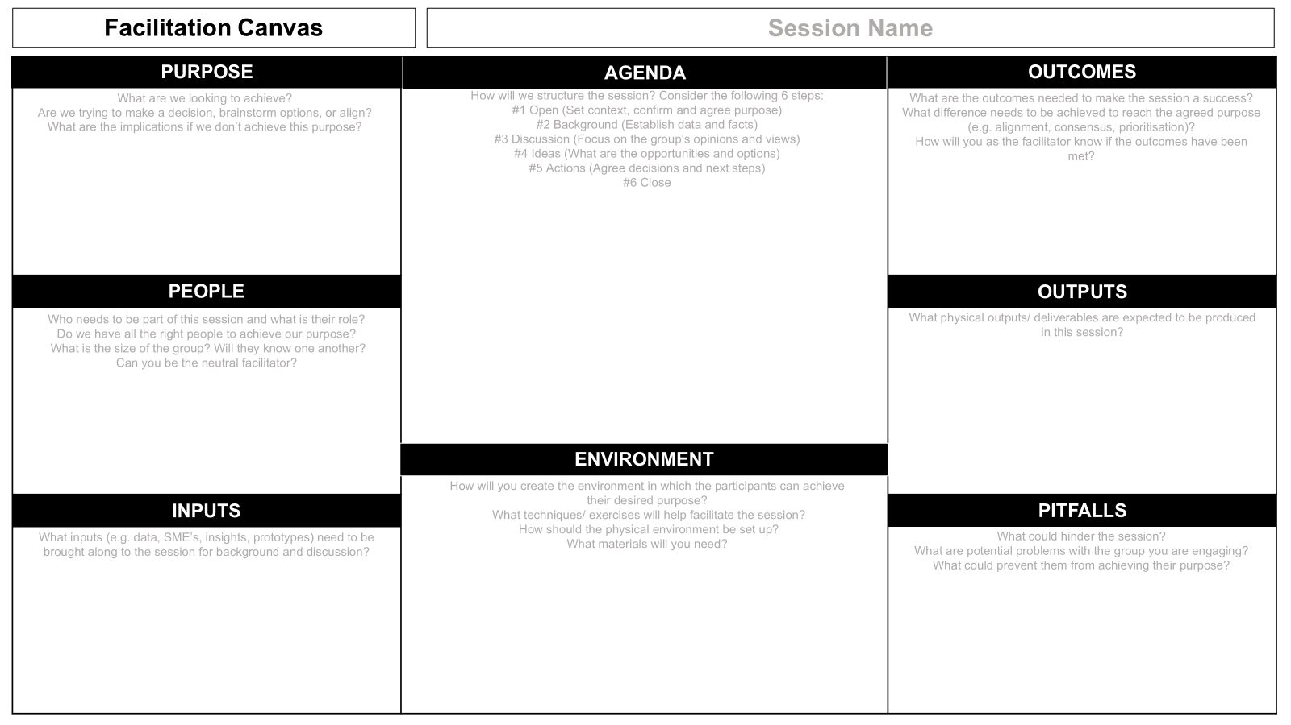
Planning for Hackathon

Slide 13
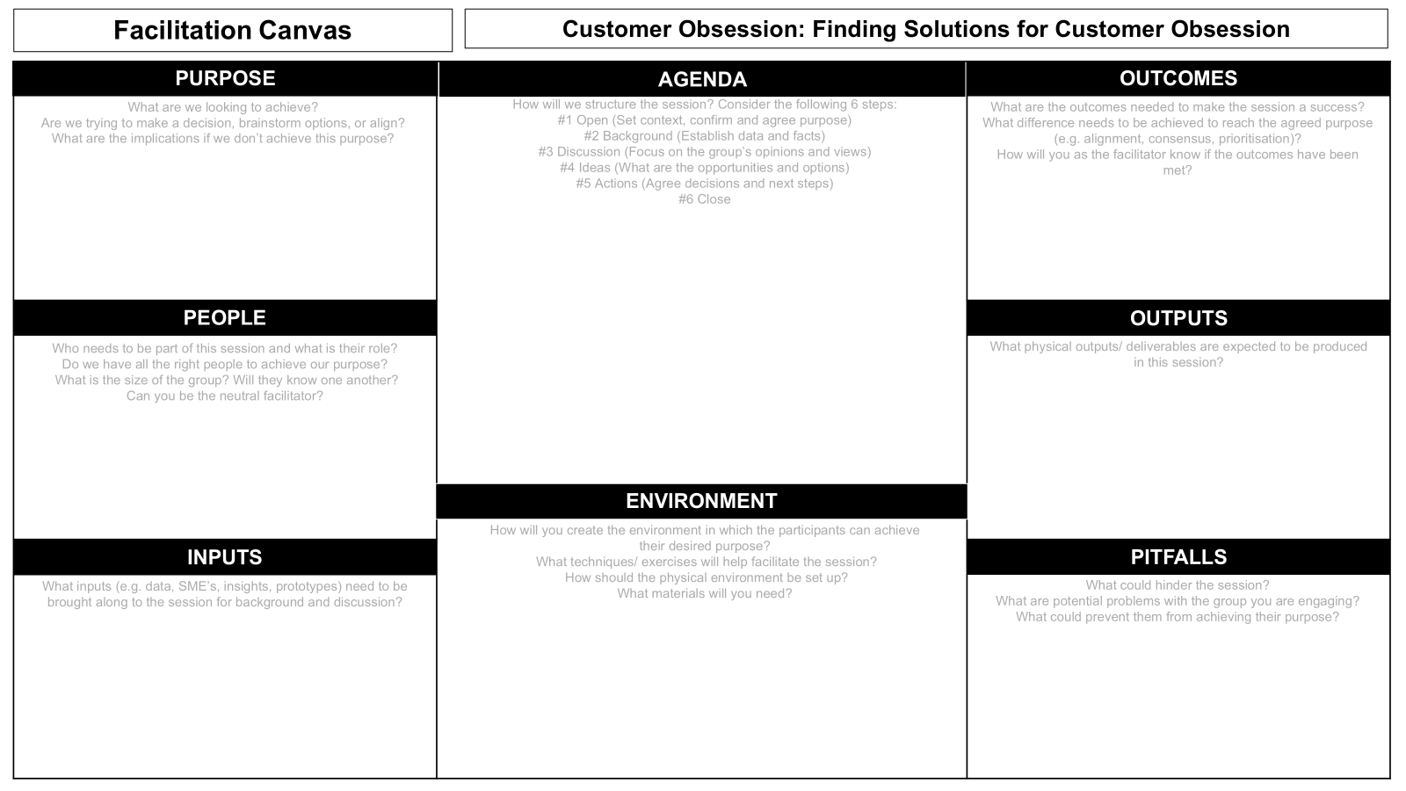
Planning for Hackathon
What are we looking to achieve?
Develop innovative solutions that enhance customer experience and satisfaction.
Foster a culture of customer obsession within the organization.
Are we trying to make a decision, brainstorm options, or align?
Brainstorm options and align on the best solutions.
Open:
Welcome and introduction.
Set the context and confirm the purpose.
Background:
Present data and facts about current customer satisfaction levels.
Share customer feedback and pain points.
Discussion:
Group discussions on the importance of customer obsession.
Share personal experiences related to customer service.
Ideas:
Brainstorm potential solutions and innovations.
Group activities to generate and refine ideas.
Actions:
Agree on the most viable solutions.
Plan the next steps and assign responsibilities.
Close:
Summarize key takeaways.
Thank participants and outline follow-up actions (how can people follow up and work on their ideas after the event is over).
What are the outcomes needed to make the session a success?
A list of actionable ideas to improve customer experience.
A committed team to implement these ideas.
What difference needs to be achieved to reach the agreed purpose?
Alignment on customer-focused strategies.
Enhanced customer satisfaction metrics.
How will you as the facilitator know if the outcomes have been met?
Feedback from participants.
Clear, actionable plans and assigned tasks.
Who needs to be part of this session and what is their role?
Product managers, customer service representatives, UX designers, and marketing professionals, customers.
Do we have all the right people to achieve our purpose?
Ensure diverse representation from various departments.
What is the size of the group? Will they know one another?
Optimal size: 20-30 participants.
Mix of familiar and new faces to encourage fresh perspectives.
What outputs/deliverables are expected to be produced in this Hackathon?
Actionable ideas and strategies to improve customer experience.
Prototypes or wireframes of new customer service tools.
A documented plan of action with assigned responsibilities.
Keep this is as light as possible, to encourage creativity.
How will you create the environment in which the participants can achieve their desired purpose?
Create a collaborative and open atmosphere.
What techniques/exercises will help facilitate the session?
Icebreakers, brainstorming sessions, group discussions, and prototyping.
How should the physical environment be set up?
Arrange seating in clusters to encourage teamwork.
Provide whiteboards, sticky notes, and markers for brainstorming, food and drinks, focus areas, virtual attendee rooms.
What materials will you need?
Projector, flip charts, markers, sticky notes, laptops, and internet access, Azure platform access.
What inputs (e.g., data, SME's, insights, prototypes) need to be brought along to the session for background and discussion?
Customer feedback data and satisfaction surveys.
Subject Matter Experts (SMEs) on customer service.
Existing customer service protocols and performance metrics.
Prototypes of current customer interaction tools.
What could hinder the session?
Lack of participation or engagement.
Dominance by a few voices.
What are potential problems with the group you are engaging?
Resistance to change.
Differing priorities among departments.
What could prevent them from achieving their purpose?
Insufficient time to explore ideas in depth.
Lack of follow-through on agreed actions.

Slide 14

Hackathon Advisor’s Assemble
Design Mentors
Their focus is on:
User Experience guidance.
User Validation Challenges.
Mentor and guide teams through the design process.
Help out if needed with final project pitch.
Team Mentors
Their focus is on:
Challenging your existing business constraints and creatively push the boundaries.
Driving for differentiation – search for stretch.
Challenging teams to break into new places.
Getting the team to work together.
Subject Matter Experts
Their focus is on:
Assisting teams on organization related questions
Providing insight into datasets or customer experience.
Tech Mentors
Their focus is on:
Supporting developers from teams where required.
Connecting capabilities where needed (ie. hooking into tech partner products).
Tech escalation point, if required.
Troubleshooting.
Assessing technical solutions.
Crew
Their focus is on:
Feeding you.
Making sure you don’t get lost.
Fixing things.
Pointing you in the direction of caffeine / mentors / fresh air.

Slide 15


Set Date, Time and Venue
Consider participant availability and potential conflicts (other events or user-groups happening, important project golives)
For in-person events, choose a venue with adequate space, strong Wi-Fi, and necessary infrastructure (parking, sponsor spaces, heating, open plan + focus spaces, accessibility, food and beverage hotspots, informal networking spaces, storage spaces (for bags, coats, prizes))
For virtual or hybrid events, select a reliable online platform (i.e. Microsoft Teams)
Create a checklist of requirements

Slide 16
Advisors (Mentors and Experts)
Identify team members or external experts who can provide guidance throughout ideation through to prototypes or presentations.
Ensure a sufficient number of mentors to support participants.
Mentors/Experts don’t need to be technical, they could be scrum-masters, legal, customers (like the Microsoft Hackathon, make sure of an NDA), marketing.
Even if they aren’t all in the room – have them easily accessible to teams!
Consider ‘Hackathon AI Copilot’ or great documentation, to help answer common questions!

Slide 17
Plan the Schedule and activities
Pre-Hackathon | Hackathon | Post-Hackathon
Planning workshops Determine High-level Project team (treat Hackathon delivery as a project) Run concept development workshops (i.e., solidify Themes, problems to tackle as part of Hackathon) Executive sponsor awareness (make sure you have executive/upper-management awareness and support for not only Hackathon, but supporting initiatives after the Hackathon ends) RACI (Responsible, Accountable, Consulted, Informed) Event Branding (Marketing) Design Thinking/Lean Canvas pitch training Pre-day Runsheet (contact details + who is doing what) Pre-day testing (technology, i.e., create Azure resources, meeting rooms) Accessibility considerations (i.e. wheelchair access) Legal and ethical considerations Team formation strategies Code of Conduct | On-site guidance and leadership Facilitation management (technical + in person) Judging Event fun and ice breaker activities Mentorship (Technical, Design thinking, presentations, Public Speaking) Technical support Hack Advisors Event facility tidy-up/rubbish collection | Post-event Survey Event retrospective Event comms (Executive sponsors + attendees) Event video, marketing Prototyping workshops for Hackathon ideas

Slide 18
High level 2-day example schedule
Day 1 | Day 2
0730 Doors open (Optional) 0745 Breakfast (Optional) 0800 Registration open & tea | coffee 0900 Kick-off 0915 Welcome 0930 First Keynote 1000 Organizational Challenge Pitches 1030 Morning Tea & team formation 1100 Teams start hacking 1200 Lunch Time & Partner Exhibits 1300 Teams continue hacking 1310 Mentors meet the teams #1 1300 Teams continue hacking 1430 Afternoon tea & Partner Exhibits 1500 Teams continue hacking 1600 Problem + Solution Canvas review 1730 Mentors meet the teams #2 1830 Shared Dinner & Guest Speaker – presentations of problem & solution thinking 1900 Team One-minute Pitch + Energiser 1930 Teams continue hacking + partners engage 2030 Entertainment 2100 Mentors meet the teams #3 2110 Teams continue 2300 Doors close | 0630 Doors open (Optional)​ 0745 Breakfast (Optional)​ 0800 Team One-minute Pitch + Energiser 0830 Teams continue hacking 0845 Team presentation practice session #1 0930 Mentors Meet the teams #4 1000 Teams continue hacking 1100 Technical set up and practice run-through 1200 Lunch Time & guest speaker 1230 Teams continue hacking 1330 Team presentation practice session #2 (Optional) 1430 Pitch presentation & judging 1630 Prize giving 1700 Wrap up 1710 Drinks and nibbles (Optional) 1830 Close

Slide 19
High level 2-day example schedule
Day 1 | Day 2
0730 Doors open (Optional) 0745 Breakfast (Optional) 0800 Registration open & tea | coffee 0900 Kick-off 0915 Welcome 0930 First Keynote 1000 Organizational Challenge Pitches 1030 Morning Tea & team formation 1100 Teams start hacking 1200 Lunch Time & Partner Exhibits 1300 Teams continue hacking 1310 Mentors meet the teams #1 1300 Teams continue hacking 1430 Afternoon tea & Partner Exhibits 1500 Teams continue hacking 1600 Problem + Solution Canvas review 1730 Mentors meet the teams #2 1830 Shared Dinner & Guest Speaker – presentations of problem & solution thinking 1900 Team One-minute Pitch + Energiser 1930 Teams continue hacking + partners engage 2030 Entertainment 2100 Mentors meet the teams #3 2110 Teams continue 2300 Doors close | 0630 Doors open (Optional)​ 0745 Breakfast (Optional)​ 0800 Team One-minute Pitch + Energiser 0830 Teams continue hacking 0845 Team presentation practice session #1 0930 Mentors Meet the teams #4 1000 Teams continue hacking 1100 Technical set up and practice run-through 1200 Lunch Time & guest speaker 1230 Teams continue hacking 1330 Team presentation practice session #2 (Optional) 1430 Pitch presentation & judging 1630 Prize giving 1700 Wrap up 1710 Drinks and nibbles (Optional) 1830 Close
“Remember to include your online attendees!
i.e. Swag, Uber Eats vouchers, Coffee vouchers, giveaways, stream entertainment.”

Slide 20
Attendee themes
FOOD
LEARN
CREATE
FUN
CONNECT

Slide 21
Team formation strategies
Cross-functional teams
Form teams of 3-5 individuals with diverse skills
Include developers, designers, and business/product leads
Ensure a mix of technical and non-technical roles
Randomized Assignment with Opt-out
Randomly assign participants to teams
Provide a short period for participants to opt-out if they feel the team is not a good fit
This approach can lead to diverse teams and unexpected collaborations
Skill Matching
Use a pre-event survey to gather participants' skills and interests
Create a skill matrix to balance teams with complementary abilities
Consider using team formation tools or algorithms to optimize matches
Virtual Icebreakers
Organize online icebreaker activities before team formation
Use virtual platforms for speed networking or interest-based matchmaking
Encourage participants to share their backgrounds and motivations
Interest-based Grouping
Allow participants to form teams based on shared interests in specific challenges or technologies
Use online forums or chat channels for participants to discuss ideas and find like-minded teammates
Hybrid Team Structure
For events with both in-person and virtual participants, create teams with a mix of on-site and remote members
Ensure each team has at least one on-site member to facilitate communication with organizers

Slide 22
Technology and Infrastructure

Slide 23
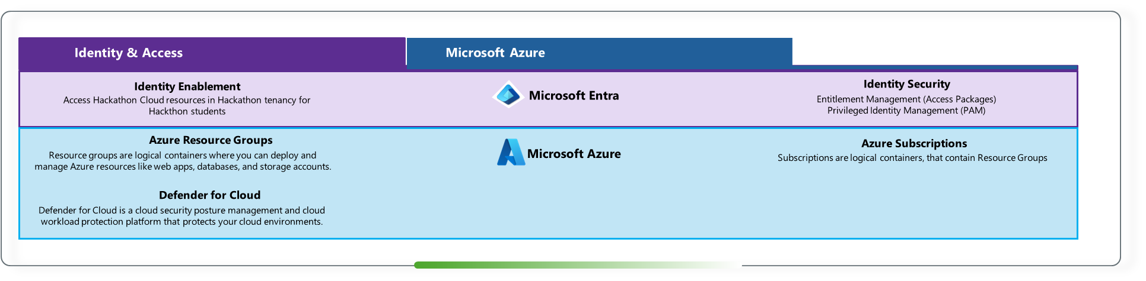
Environment technology

Slide 24
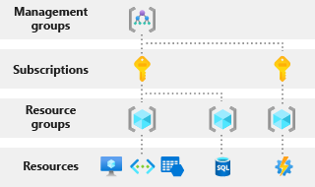
Environment concepts
Management Group
Hackathon Management Group
Subscription A
Resource Group
Resource

Slide 25
Sandbox types

Slide 26
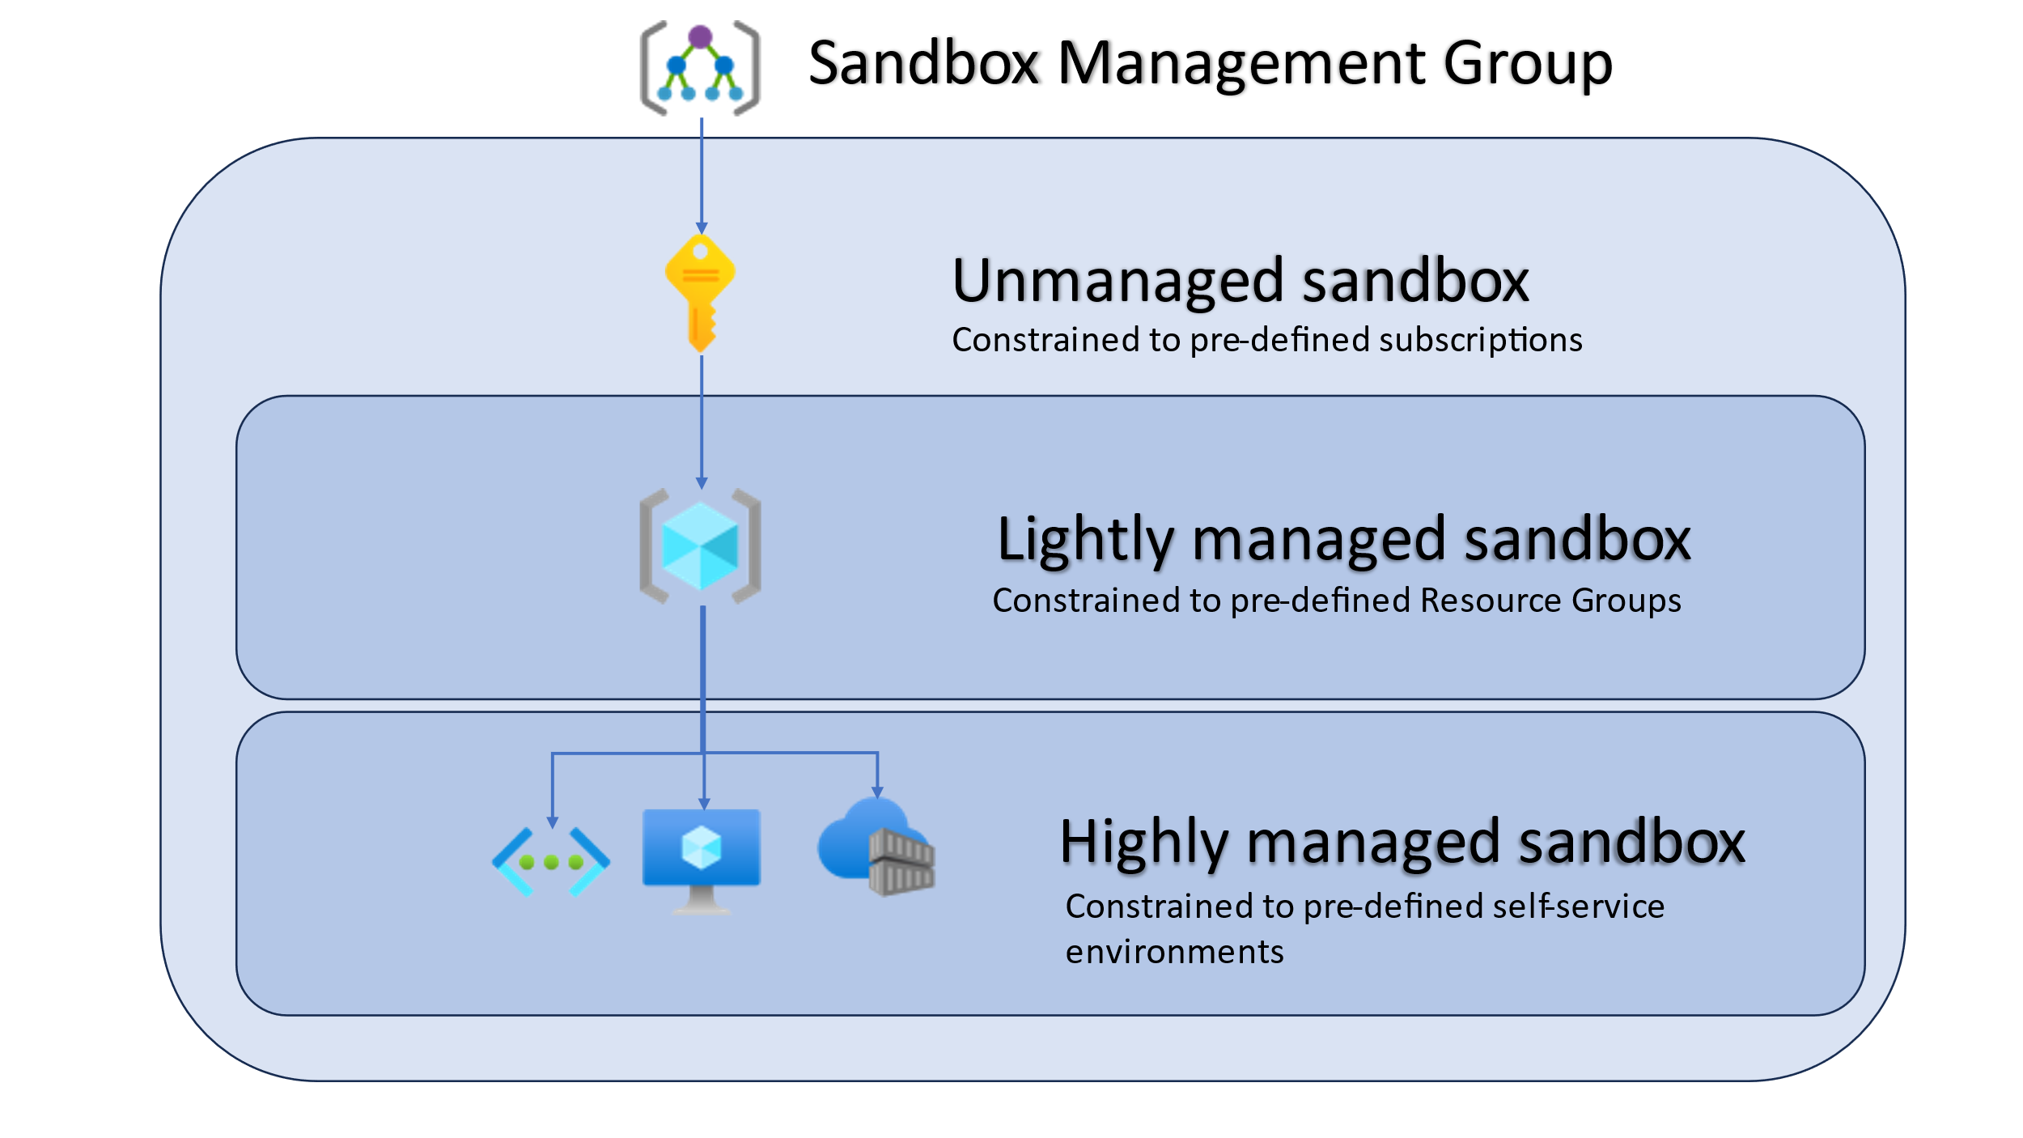
Sandbox types
Ability for Sandbox consumers to configure
Administered
on the
Sandbox consumers behalf

Slide 27
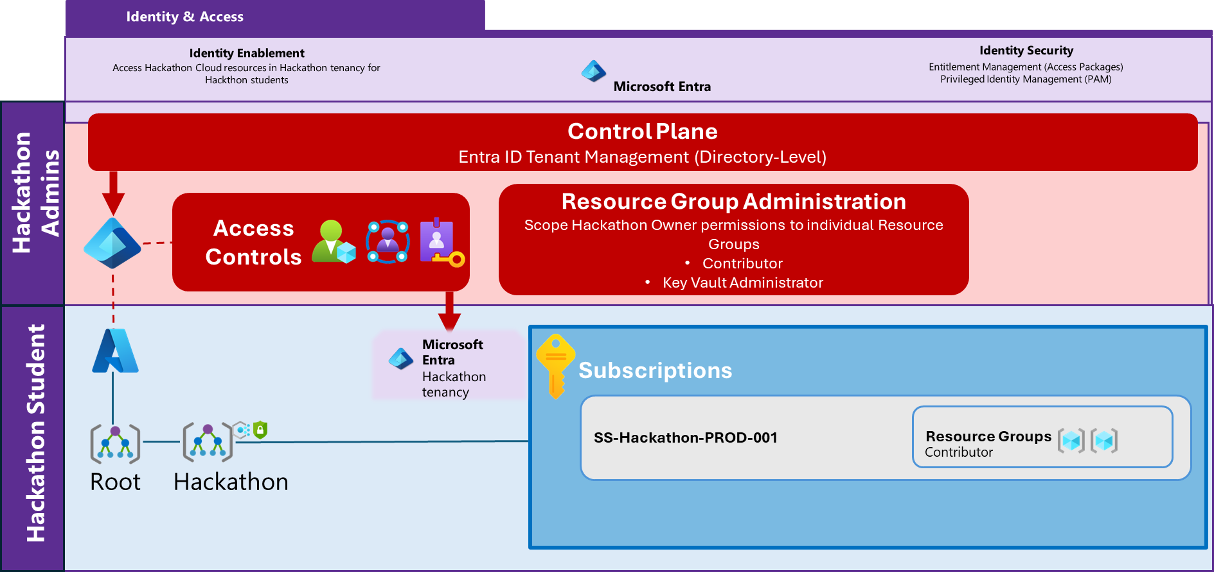
Identity & Access

Slide 28
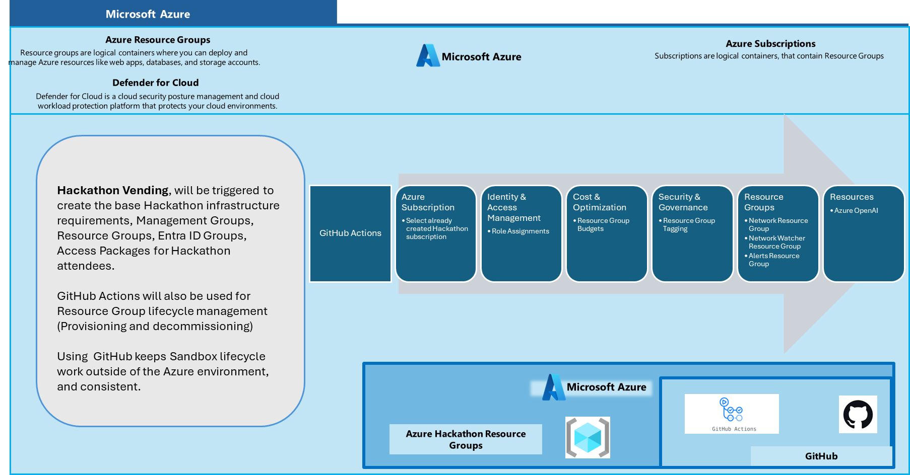
Hackathon Vending
https://luke.geek.nz/azure/hackathon-vending-project/

Slide 29
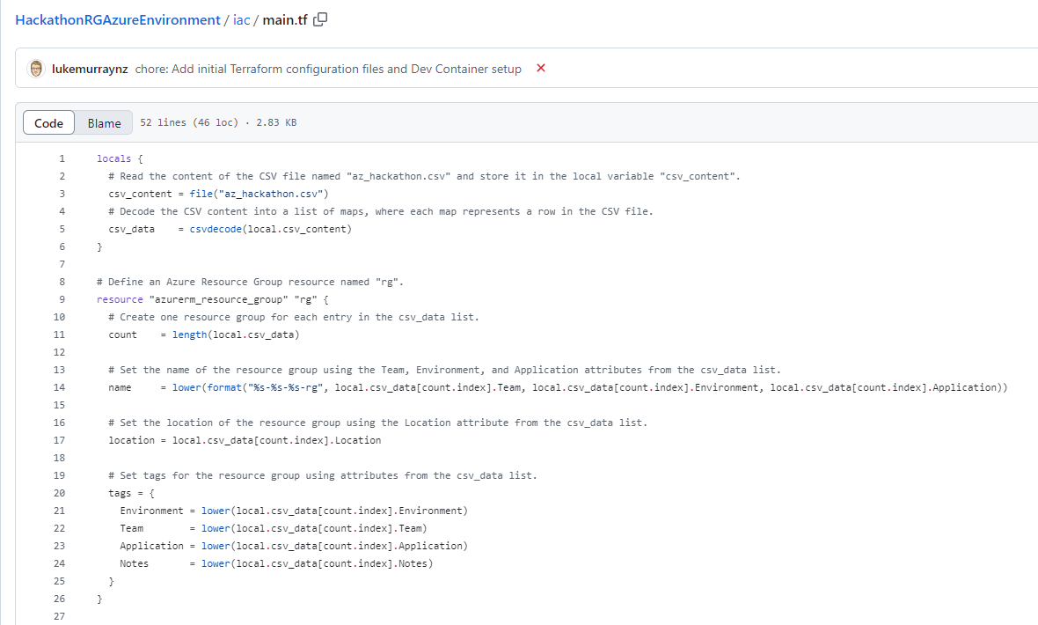
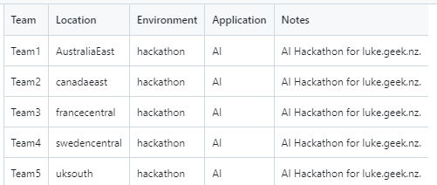
Hackathon Vending
https://luke.geek.nz/azure/hackathon-vending-project/

Slide 30
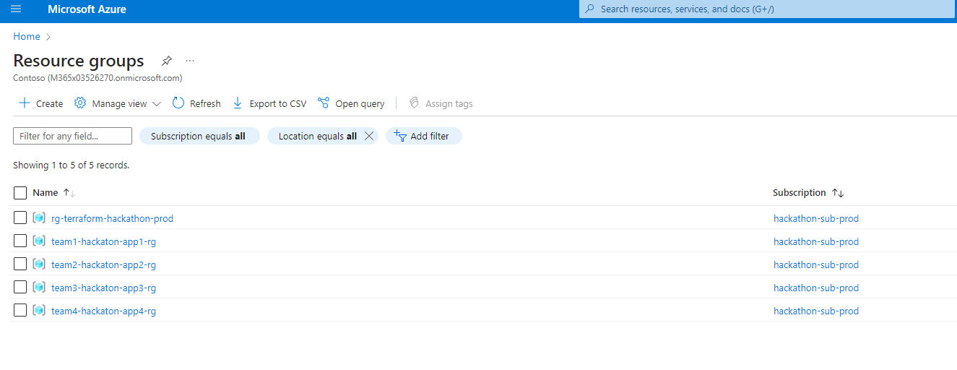
Hackathon Vending
https://luke.geek.nz/azure/hackathon-vending-project/

Slide 31
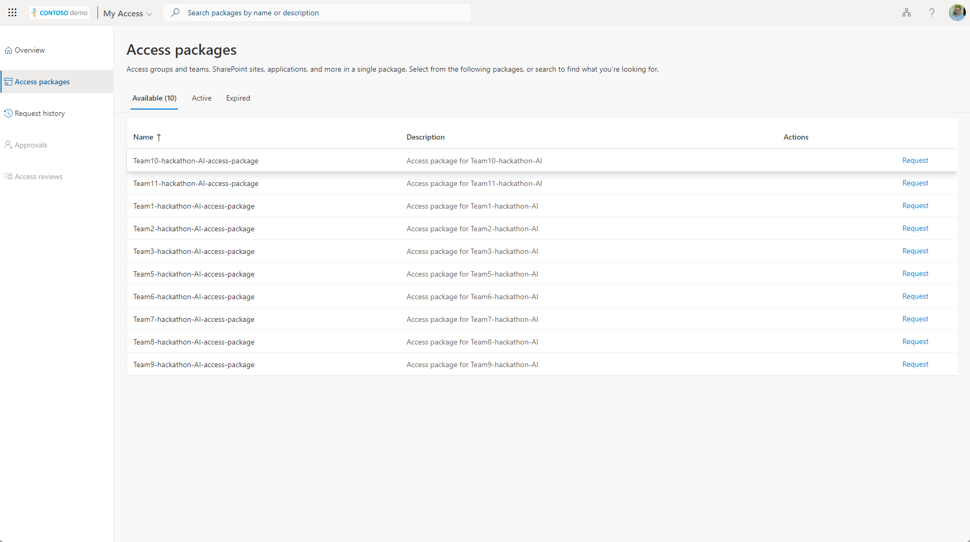
Hackathon Vending
https://luke.geek.nz/azure/hackathon-vending-project/

Slide 32
Fostering Innovation and Creativity

Slide 33
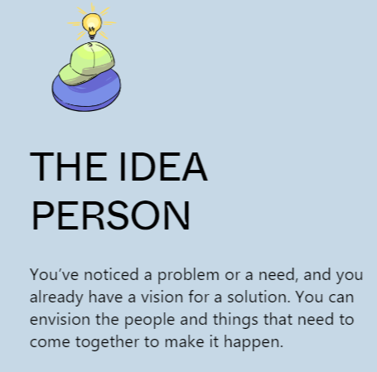
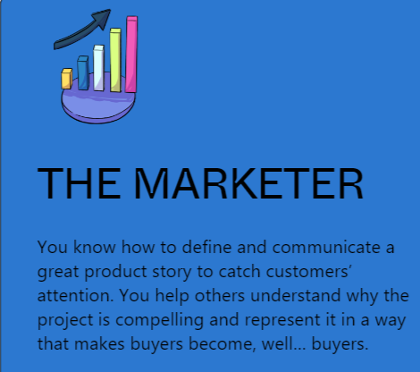
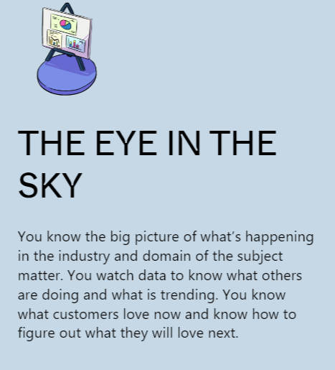

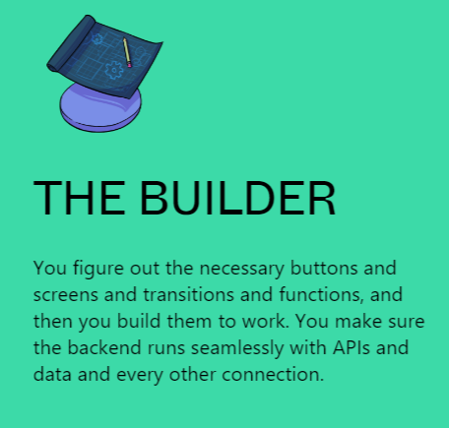
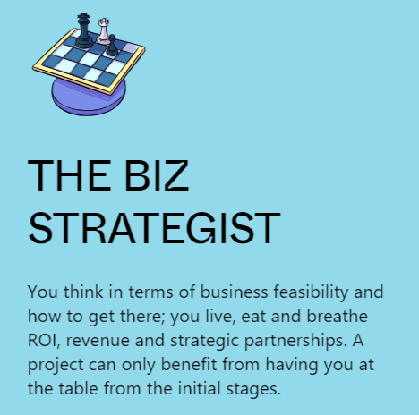
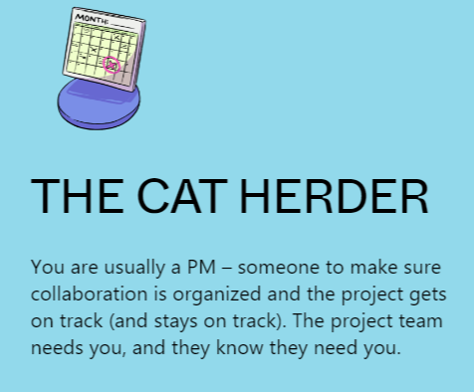
Hackers

Slide 34
Evaluation and Judging

Slide 35
Q. What would you be Judging a Hackathon project for?

Slide 36
Judging criteria
Execution
The concept has been technically well architected and translated into the working prototype
Experience
Concept is well thought-out from a CX / human-centred design perspective, accessibility, organizational value alignment.
Use of Data
Leverages first and/or third-party data in unique and sophisticated ways. Demonstrate insights through data analysis
Impact
The concept is likely to make a significant contribution to solve problems, in alignment with Hackathon goals
Presentation
Pitch quality – verbal and visual communication
Ability to implement
The concept is realistically achievable with appropriate resourcing

Slide 37
Hacker Pitch notes
Less is more
Include something memorable, such as a logo and name for your app.
Tell a story
Follow a narrative arc – the problem the protagnoist (solution) how the it’s all going to play out
Make it personal
User reference points, the word you, a personal story
Use your mentors
NOT to deliver your pitch, but use their knowledge whether presentation, or commercialization to help frame your presentation.
Don’t boil the ocean
Try to keep on target in your presentation and demos
Anticipate questions
Try to ask yourself, what questions would you ask about your project and include them in your presentation.
Own the stage
Speak bold and loud and confident, use your voice to your advantage
Have fun with it, laugh at your mistakes, and acknowledge them
Passion and laughter are infectious
Show your passion, celebrate at the journey and learnings you have been through!

Slide 38
Prizes and Recognition

Slide 39
Prizes and Recognitions
Monetary Prizes
Career Development
Project Support
Technology and Tools
Learning Opportunities
Recognition
Company-Specific rewards
Health and Wellness
Experiences
Networking

Slide 40
Lean and Design Thinking
Resources

Slide 42
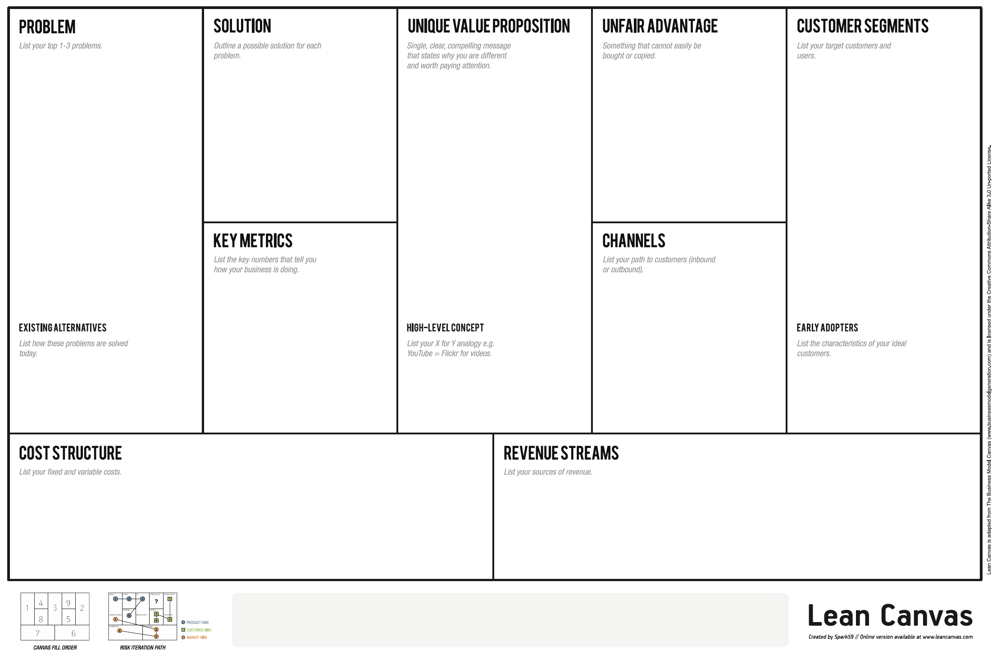

Slide 43
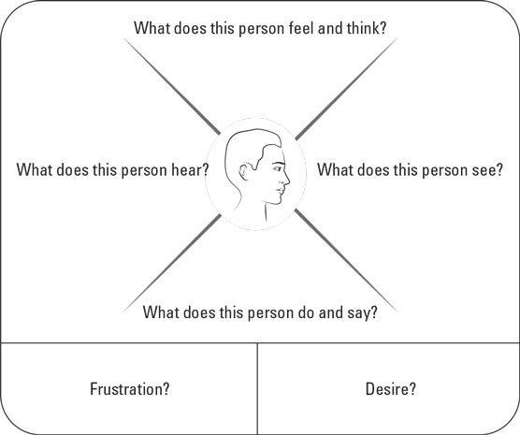

Slide 44



Big Ideas: Idea Name
PROBLEM/ POINT OF VIEW
IDEA BLUEPRINT
User, need and insight
ABSTRACT/ INSIGHT
KEY BENEFITS
KPI
TECH NOTES
KPIS
Business impact
high
Cost
high
User experience
high
Technology Quotient
low
Quick Win Potential
high

Slide 45
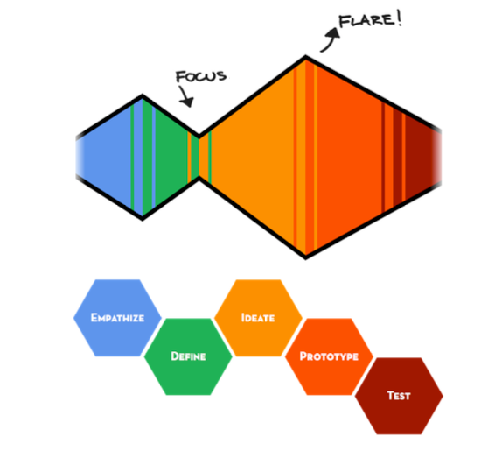

Slide 46
